Slide 1
Construction of Activity-On-Node (AON) PERT Diagram from Project Schedule

Slide 2
Characteristics of Activity-On-Node (AON) PERT Diagram
Maybe more than one single start and end node.
Nodes represent activities.
Arrows indicate precedence.
Example:
Activity | Predecessor
A | None
B | None
C | A
D | B, C
E | D
A
C
B
D
E

Slide 3
Activity-On-Node (AON) PERT Diagram Example
Activity | Predecessor
A | None
B | A
C | A
D | B, C
E | D
B
A
D
E
C

Slide 4
Activity-On-Node (AON) PERT Diagram Example
Activity | Predecessor
A | None
B | None
C | None
D | A, B
E | B
F | B, C
A
D
B
E
C
F

Slide 5
Activity-On-Node (AON) PERT Diagram Example
Activity | Predecessor
A | None
B | A
C | A
D | B
E | C
F | D, E
B
D
A
F
C
E

Slide 6
Activity-On-Node (AON) PERT Diagram Example
Activity | Predecessor
A | None
B | A
C | A
D | B
E | B, C
F | C
G | D, E, F
B
D
A
E
G
C
F

Slide 7
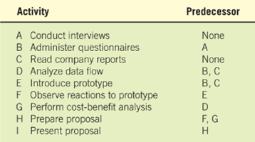
Activity-On-Node (AON) PERT Diagram Example
A
B
D
G
H
I
C
E
F

